Slide 1
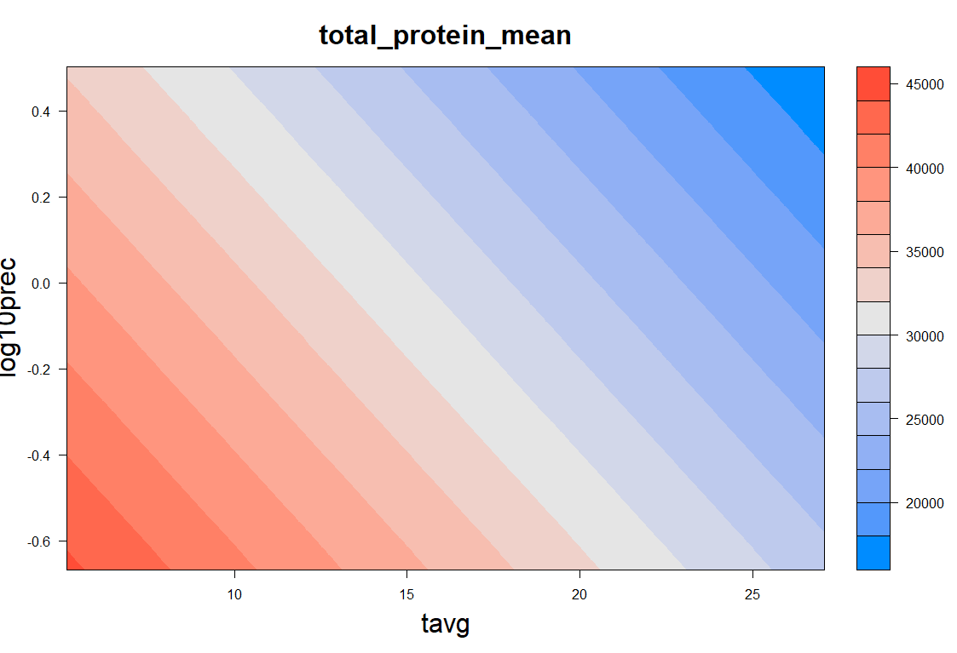
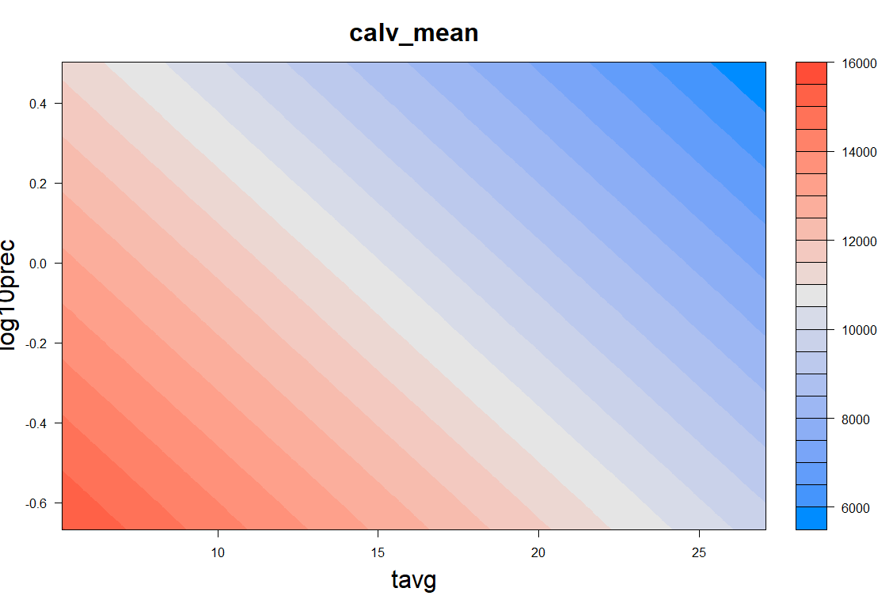
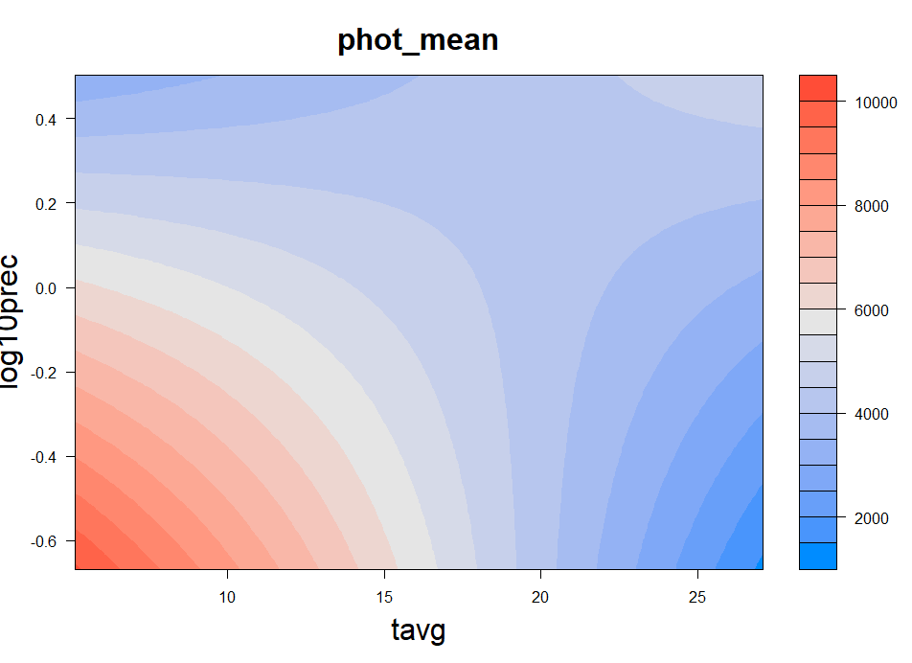
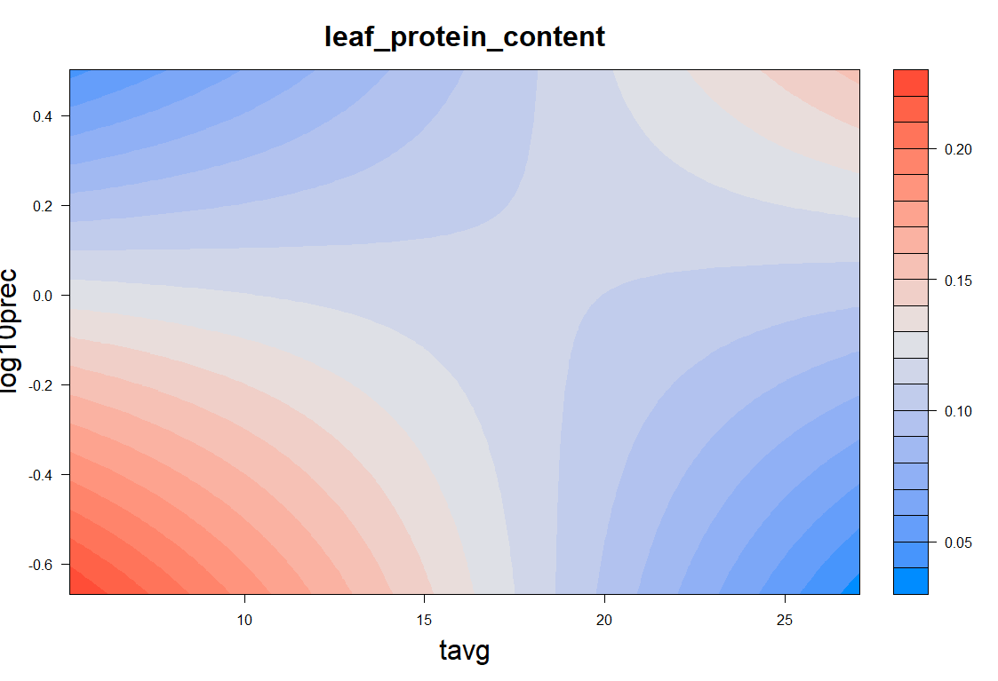
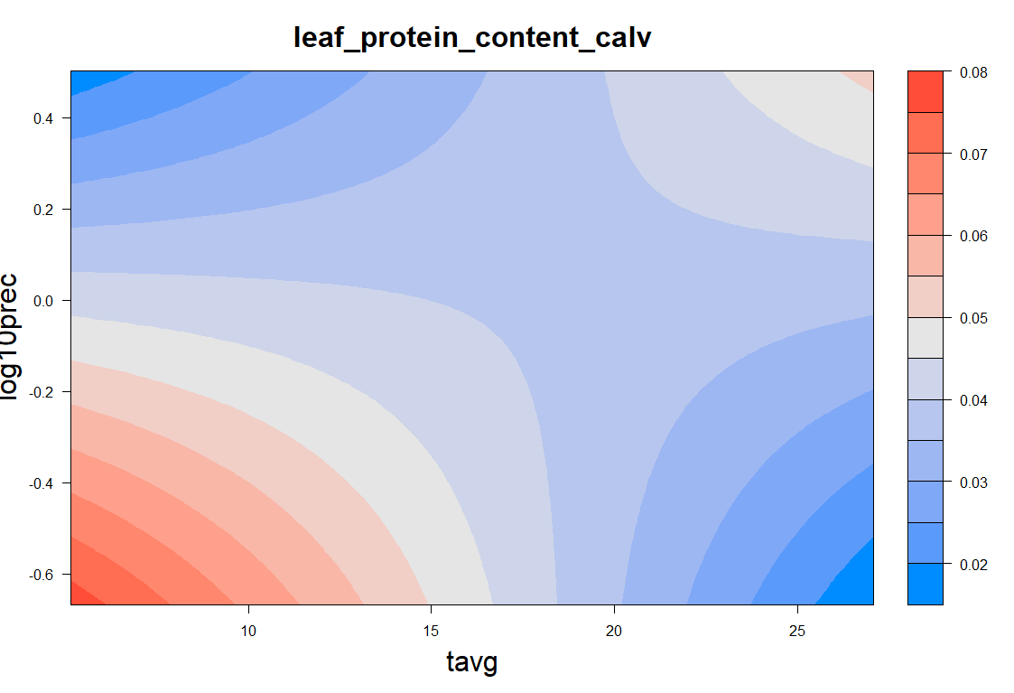
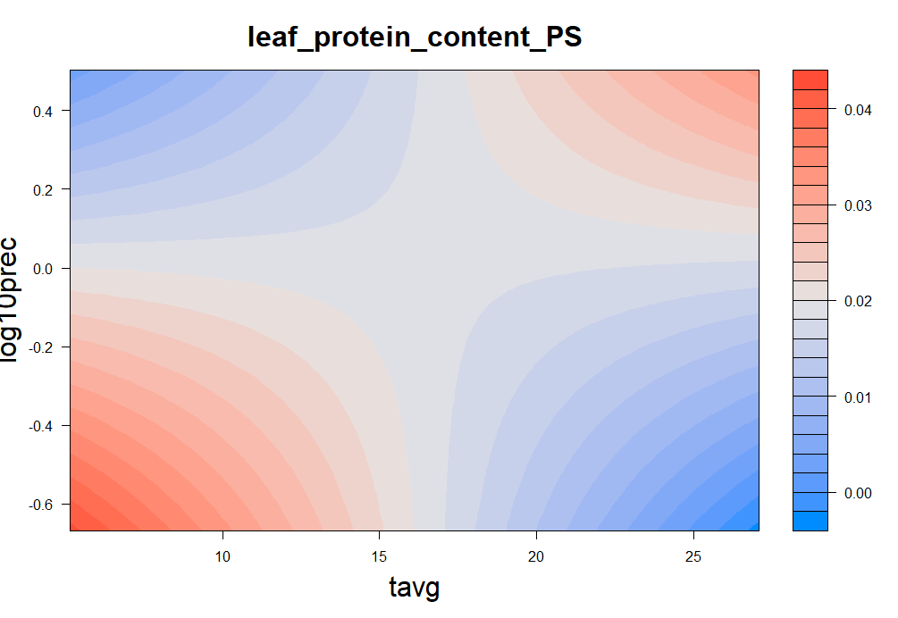
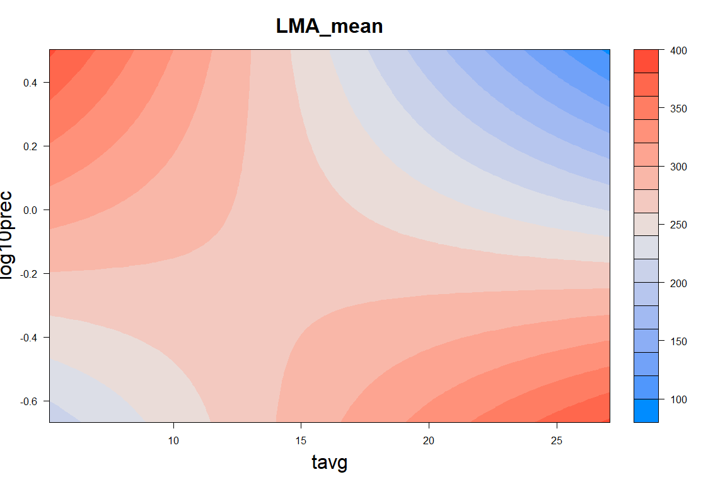

Slide 2
TOTAL PROTEIN
PHOTOSYSTEMS
CALVIN CYCLE
lm(formula = total_protein_mean ~ tavg + log10prec, data = data)
Residuals:
Min 1Q Median 3Q Max
-6191.1 -3466.9 -526.6 1950.9 10682.8
Coefficients:
Estimate Std. Error t value Pr(>|t|)
(Intercept) 42491.3 2397.6 17.723 < 2e-16 ***
tavg -804.3 127.5 -6.311 3.88e-07 ***
log10prec -9106.4 2903.9 -3.136 0.00359 **
---
Signif. codes: 0 ‘***’ 0.001 ‘**’ 0.01 ‘*’ 0.05 ‘.’ 0.1 ‘ ’ 1
Residual standard error: 4462 on 33 degrees of freedom
Multiple R-squared: 0.6105, Adjusted R-squared: 0.5869
F-statistic: 25.86 on 2 and 33 DF, p-value: 1.754e-07
lm(formula = phot_mean ~ tavg * log10prec, data = data)
Residuals:
Min 1Q Median 3Q Max
-1382.1 -752.0 -150.9 341.2 2214.5
Coefficients:
Estimate Std. Error t value Pr(>|t|)
(Intercept) 6754.61 538.63 12.540 6.81e-14 ***
tavg -124.75 28.52 -4.374 0.000121 ***
log10prec -8038.56 2709.54 -2.967 0.005654 **
tavg:log10prec 406.63 134.20 3.030 0.004809 **
---
Signif. codes: 0 ‘***’ 0.001 ‘**’ 0.01 ‘*’ 0.05 ‘.’ 0.1 ‘ ’ 1
Residual standard error: 995.4 on 32 degrees of freedom
Multiple R-squared: 0.4896, Adjusted R-squared: 0.4418
F-statistic: 10.23 on 3 and 32 DF, p-value: 7.057e-05
lm(formula = calv_mean ~ tavg + log10prec, data = data)
Residuals:
Min 1Q Median 3Q Max
-3067.0 -1151.5 10.3 1164.3 3989.2
Coefficients:
Estimate Std. Error t value Pr(>|t|)
(Intercept) 14503.84 904.55 16.034 < 2e-16 ***
tavg -264.48 48.09 -5.500 4.21e-06 ***
log10prec -3583.82 1095.56 -3.271 0.00251 **
---
Signif. codes: 0 ‘***’ 0.001 ‘**’ 0.01 ‘*’ 0.05 ‘.’ 0.1 ‘ ’ 1
Residual standard error: 1683 on 33 degrees of freedom
Multiple R-squared: 0.5647, Adjusted R-squared: 0.5384
F-statistic: 21.41 on 2 and 33 DF, p-value: 1.095e-06
lm(formula = leaf_protein_content ~ log10prec * tavg, data = data)
Residuals:
Min 1Q Median 3Q Max
-0.042075 -0.017959 0.002458 0.011954 0.039139
Coefficients:
Estimate Std. Error t value Pr(>|t|)
(Intercept) 0.1307301 0.0112051 11.667 4.59e-13 ***
log10prec -0.2168633 0.0563660 -3.847 0.000537 ***
tavg -0.0010396 0.0005933 -1.752 0.089316 .
log10prec:tavg 0.0117442 0.0027917 4.207 0.000195 ***
---
Signif. codes: 0 ‘***’ 0.001 ‘**’ 0.01 ‘*’ 0.05 ‘.’ 0.1 ‘ ’ 1
Residual standard error: 0.02071 on 32 degrees of freedom
Multiple R-squared: 0.4167, Adjusted R-squared: 0.362
F-statistic: 7.62 on 3 and 32 DF, p-value: 0.0005565
lm(formula = leaf_protein_content_PS ~ log10prec * tavg, data = data)
Residuals:
Min 1Q Median 3Q Max
-0.0085160 -0.0030634 0.0002078 0.0016829 0.0089146
Coefficients:
Estimate Std. Error t value Pr(>|t|)
(Intercept) 0.0206617 0.0023728 8.708 5.97e-10 ***
log10prec -0.0489781 0.0119360 -4.103 0.000262 ***
tavg -0.0001183 0.0001256 -0.942 0.353280
log10prec:tavg 0.0029242 0.0005912 4.947 2.32e-05 ***
---
Signif. codes: 0 ‘***’ 0.001 ‘**’ 0.01 ‘*’ 0.05 ‘.’ 0.1 ‘ ’ 1
Residual standard error: 0.004385 on 32 degrees of freedom
Multiple R-squared: 0.5185, Adjusted R-squared: 0.4734
F-statistic: 11.49 on 3 and 32 DF, p-value: 2.848e-05
lm(formula = leaf_protein_content_calv ~ log10prec * tavg, data = data)
Residuals:
Min 1Q Median 3Q Max
-0.018048 -0.005486 0.001328 0.004718 0.016360
Coefficients:
Estimate Std. Error t value Pr(>|t|)
(Intercept) 0.0448830 0.0044311 10.129 1.66e-11 ***
log10prec -0.0712276 0.0222904 -3.195 0.00313 **
tavg -0.0003274 0.0002346 -1.395 0.17257
log10prec:tavg 0.0037685 0.0011040 3.414 0.00176 **
---
Signif. codes: 0 ‘***’ 0.001 ‘**’ 0.01 ‘*’ 0.05 ‘.’ 0.1 ‘ ’ 1
Residual standard error: 0.008189 on 32 degrees of freedom
Multiple R-squared: 0.3135, Adjusted R-squared: 0.2491
F-statistic: 4.871 on 3 and 32 DF, p-value: 0.006679
lm(formula = LMA_mean ~ tavg * log10prec, data = data)
Residuals:
Min 1Q Median 3Q Max
-64.49 -35.49 -11.89 45.37 101.53
Coefficients:
Estimate Std. Error t value Pr(>|t|)
(Intercept) 330.483 27.313 12.100 1.76e-13 ***
tavg -4.115 1.446 -2.846 0.00767 **
log10prec 241.291 137.396 1.756 0.08863 .
tavg:log10prec -17.996 6.805 -2.645 0.01257 *
---
Signif. codes: 0 ‘***’ 0.001 ‘**’ 0.01 ‘*’ 0.05 ‘.’ 0.1 ‘ ’ 1
Residual standard error: 50.47 on 32 degrees of freedom
Multiple R-squared: 0.4525, Adjusted R-squared: 0.4012
F-statistic: 8.816 on 3 and 32 DF, p-value: 0.0002095
lm(formula = LMA_mean ~ tavg * log10prec, data = data)
Residuals:
Min 1Q Median 3Q Max
-64.49 -35.49 -11.89 45.37 101.53
Coefficients:
Estimate Std. Error t value Pr(>|t|)
(Intercept) 330.483 27.313 12.100 1.76e-13 ***
tavg -4.115 1.446 -2.846 0.00767 **
log10prec 241.291 137.396 1.756 0.08863 .
tavg:log10prec -17.996 6.805 -2.645 0.01257 *
---
Signif. codes: 0 ‘***’ 0.001 ‘**’ 0.01 ‘*’ 0.05 ‘.’ 0.1 ‘ ’ 1
Residual standard error: 50.47 on 32 degrees of freedom
Multiple R-squared: 0.4525, Adjusted R-squared: 0.4012
F-statistic: 8.816 on 3 and 32 DF, p-value: 0.0002095
lm(formula = LMA_mean ~ tavg * log10prec, data = data)
Residuals:
Min 1Q Median 3Q Max
-64.49 -35.49 -11.89 45.37 101.53
Coefficients:
Estimate Std. Error t value Pr(>|t|)
(Intercept) 330.483 27.313 12.100 1.76e-13 ***
tavg -4.115 1.446 -2.846 0.00767 **
log10prec 241.291 137.396 1.756 0.08863 .
tavg:log10prec -17.996 6.805 -2.645 0.01257 *
---
Signif. codes: 0 ‘***’ 0.001 ‘**’ 0.01 ‘*’ 0.05 ‘.’ 0.1 ‘ ’ 1
Residual standard error: 50.47 on 32 degrees of freedom
Multiple R-squared: 0.4525, Adjusted R-squared: 0.4012
F-statistic: 8.816 on 3 and 32 DF, p-value: 0.0002095

